Slide 1

E-Classroom System
Team-4
Duo Zhang

Slide 2
Introduction
Quick Review About E-classroom sys:
1.Web based system. (Do not need to consider Cross-platform issues)
2.Using html5+JSP(SSH-Struts-Spring-Hibernate)
3.Prove basic support to Students&Teachers about enroll courses& manage
What’s new in this iteration:
1. Finish most parts of the webpage design(using Html5)
2. Fix the compatibility issues when using ios to browse the website

Slide 3
Content
A
Share some interesting points when we develop this system.
Content
B
Share the website
In this presentation
C
Conclusion & Next step

Slide 4



Interesting Points
Integration JSP and html5
Compatibility issues in iOS
Auto login 2nd Edition
Nested the div class into the jsp pages
Add images with
Different kinds of
Pixels
Create links for different devices
Save Key-value pair
Into cookie

Slide 5

QR-Code
Citation Page
http://exdn.v084.10000net.cn/

Slide 6
Thank you

Slide 7



Compatibility for two main platfrom
60%
No problem
display normal
Some .png images
Can not display properly
40%
BACK
According to Survey from: http://www.businessinsider.com/smartphone-survey

Slide 8
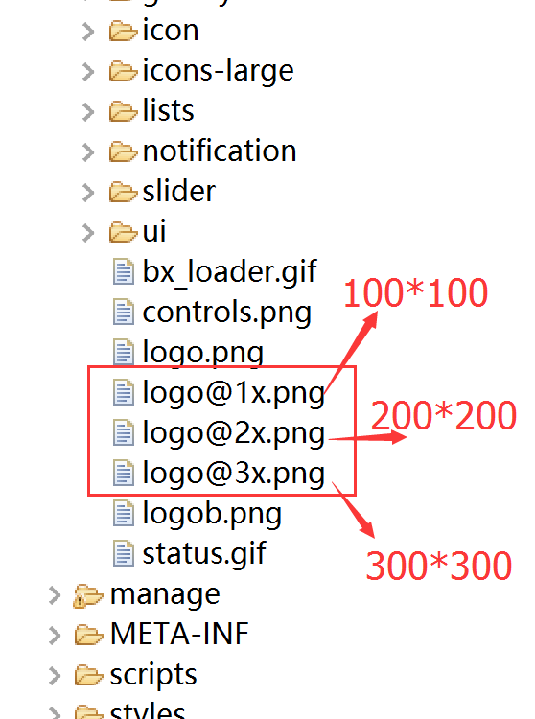
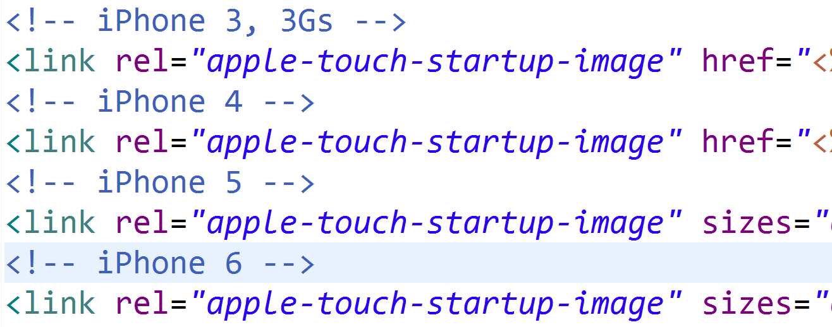
For the icon that have problem
Add links for different kinds of iphones
BACK

Slide 9
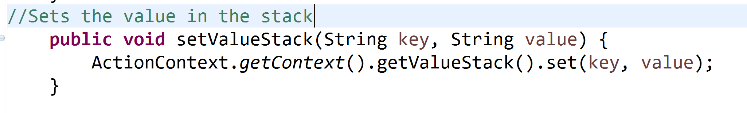
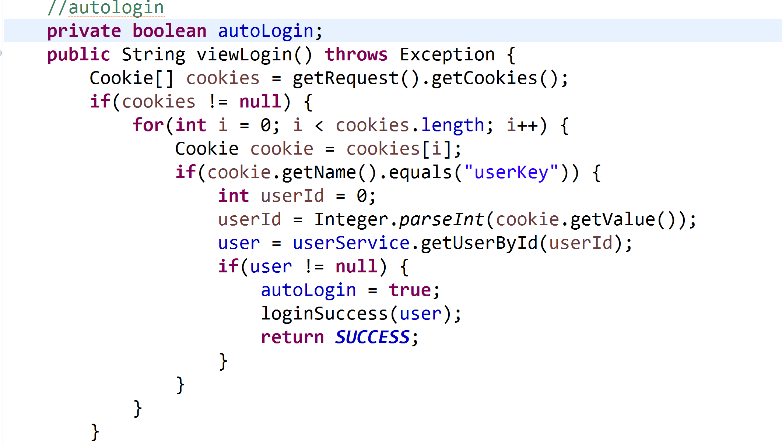
BACK

Slide 10
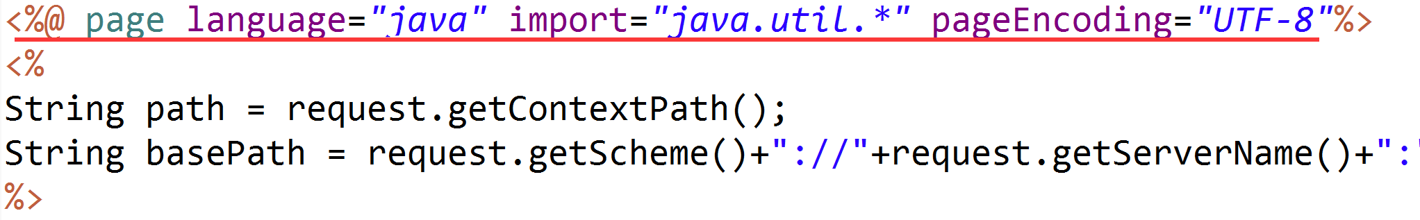
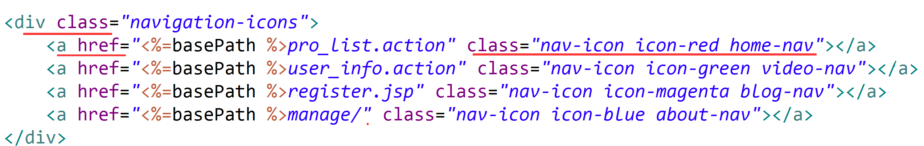
Different of JSP pages and Html5 pages
Nested the div class and links of style classes into the JSP pages
BACK

Slide 11
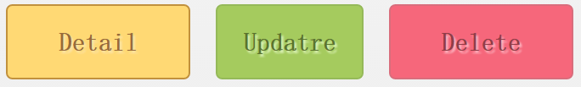





Citation Page
1. Html5 frame: “Flaty Mobile Retina”
Author: Flaty Group Time: 3/15/2013
2. ICONS: http://www.zcool.com.cn/
Author: LuoTuo Time: 10/9/2014
3. ICONS: http://semantic-ui.com/
Author: semantic-ui.com Time: Unknow
4. ICONS &Buttons: “Flaty Mobile Retina”
Author: Flaty Group Time: 3/15/2013
Next

Slide 12
Citation Page
1. PPT icons: “General icons Collection” From :http://www.zcool.com.cn/
Author: Alex Bao Time: JAN/2015
2. PPT Background: “Warm gradients” From :http://www.zcool.com.cn/
Author: Pen’s world Time: Sep/2016
Back

